Slide 1
1 Introduction

Slide 2
Highlights
Uses of Computer Networks
Network Hardware
Network Software
Reference Models
Example Networks
Network Standardization

Slide 3
Computer Networks
Computer Networks
A collection of autonomous computers interconnected by a single technology
Users are exposed to the actual machines
If the machines have different hardware and different operating systems, that is fully visible to the users

Slide 4
Distributed system
Distributed system
A collection of independent computers appears to its users as a single coherent system
A layer of software on top of the operating system, called middleware, is responsible for implementing this model
A well-known example of a distributed system is the World Wide Web, in which everything looks like a document (Web page)

Slide 5
Definition of Computer Networks
Components of CN
Computers/Hosts/End Systems
Communication Links
Switches/Routers
Notes:
End System(host): Computing Devices 不仅是计算机（台式机/笔记本），还有PDA、手机、电视、家用电器、汽车、传感设备、Web相机、数字相框…
类比：交通网络
如100台电视要使用2辆卡车从广东的厂家运到北京国美商场
Host: 建筑物，
Packets：卡车，每辆车独立运送
Links: 铁路、公路
Switch：立交桥
Application/Services: Email, Web surfing, Instant Messaging(QQ), Streaming Video(土豆网)，VoIP…

Slide 6
1.1 Uses of Computer Networks

Slide 7
Business Applications

Slide 8
Resource Sharing
Sharing physical resources
Printers
Scanners
CD burners
Sharing computerized information
Database
Documents

Slide 9
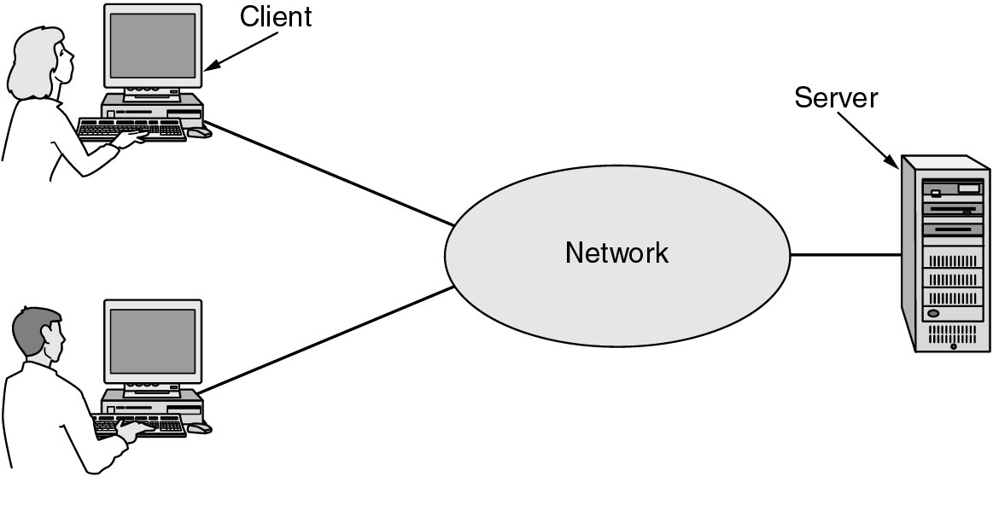
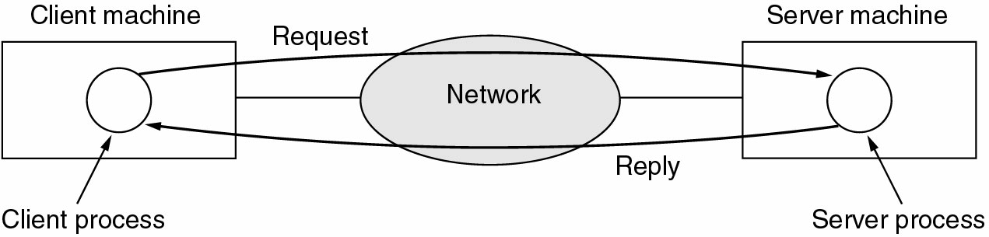
Client-Server Model
A network with two clients and one server
Notes:
服务器存储资源、提供服务（应用）

Slide 10
Communication Medium
E-mail
Makes cooperation among far-flung groups of people easy
Videoconferencing
Notes:
far-flung adj
1) long distance away 遥远的
expeditions to the far-flung corners of the world 去世界偏远地方的探险
2) spread over a wide area 分布广的；广泛的

Slide 11
Electronic Commerce
Doing business electronically with other companies, especially suppliers and customers
Reduces the need for large inventories and enhances efficiency
Doing business with consumers over the Internet
Airlines, bookstores, and music vendors …
Notes:
Enterprise Resource Planning
B-B
B-C
C-C

Slide 12
Home Network Applications

Slide 13
Access to remote information
Surfing the World Wide Web for information
Newspapers, magazines, scientific journals
On-line digital library

Slide 14
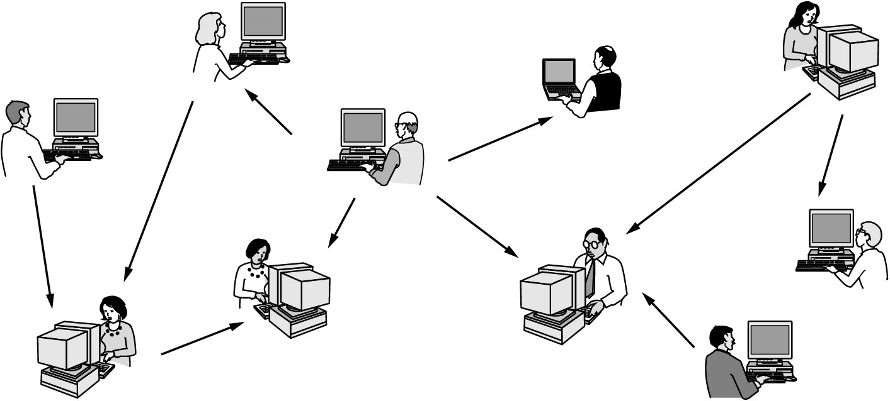
Person-to-person communication
Instant messaging
Chat room
Newsgroups
Peer-to-peer system
Carry telephone calls, video phone, radio
Notes:
P2P: 没有固定的客户/服务器角色

Slide 15
Interactive entertainment
Video on demand
Game playing

Slide 16
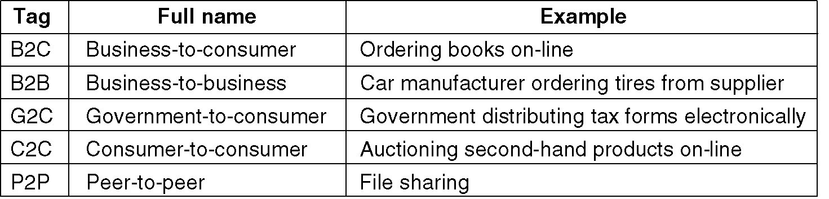
E-commerce
Some forms of e-commerce

Slide 17
Mobile Network Users

Slide 18
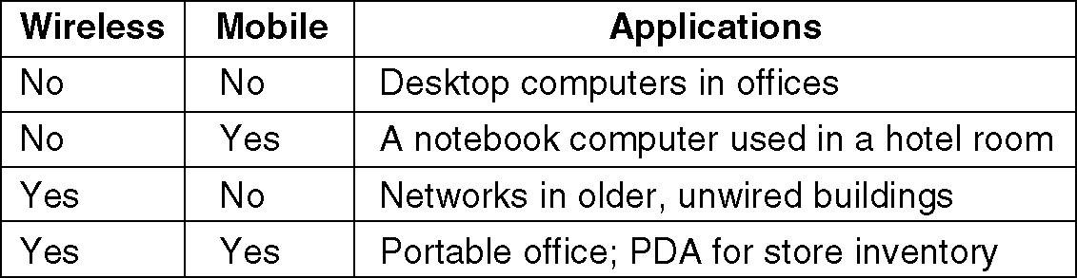
Mobile Network Users
Combinations of wireless networks and mobile computing.
Notes:
家庭无线LAN
手机上网

Slide 19
Mobile Network Users
Portable office
Trucks, taxis, …, keeping in contact with home
Meter reading
RFID
Notes:
Radio Frequency Identification电子标签，无接触识别
可承载比条形码更丰富的信息，例如商品货号、生产日期、到库日期…

Slide 20
Social Issues

Slide 21
1.2 Network Hardware

Slide 22
Transmission technology and scale

Slide 23
Transmission technology
Broadcast networks
Sending a packet to all destinations, each machine checks the address field
If the packet is intended for the receiving machine, that machine processes the packet
If the packet is intended for some other machine, it is just ignored.
Broadcasting
Multicasting (subscribe)
Point-to-point networks
To go from the source to the destination, a packet may visit one or more intermediate machines (Often multiple routes are possible, finding good ones is important)

Slide 24
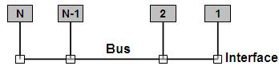
Broadcast vs. Point-to-point
A broadcast network
A point-to-point network

Slide 25
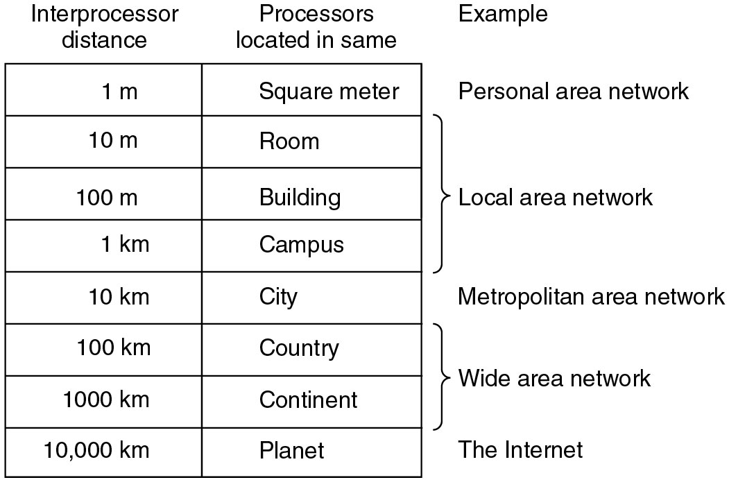
Classification by scale

Slide 26
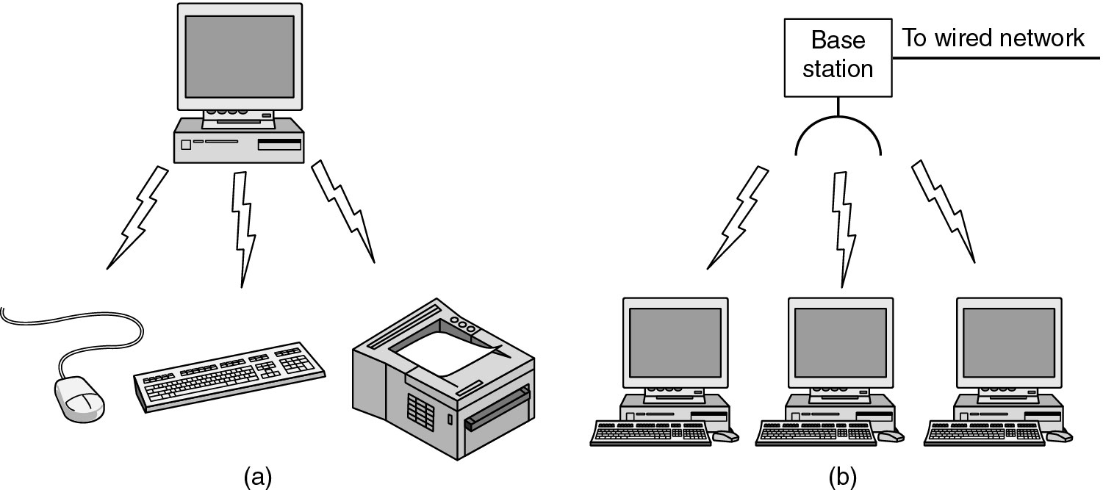
PAN

Slide 27
Local Area Networks

Slide 28
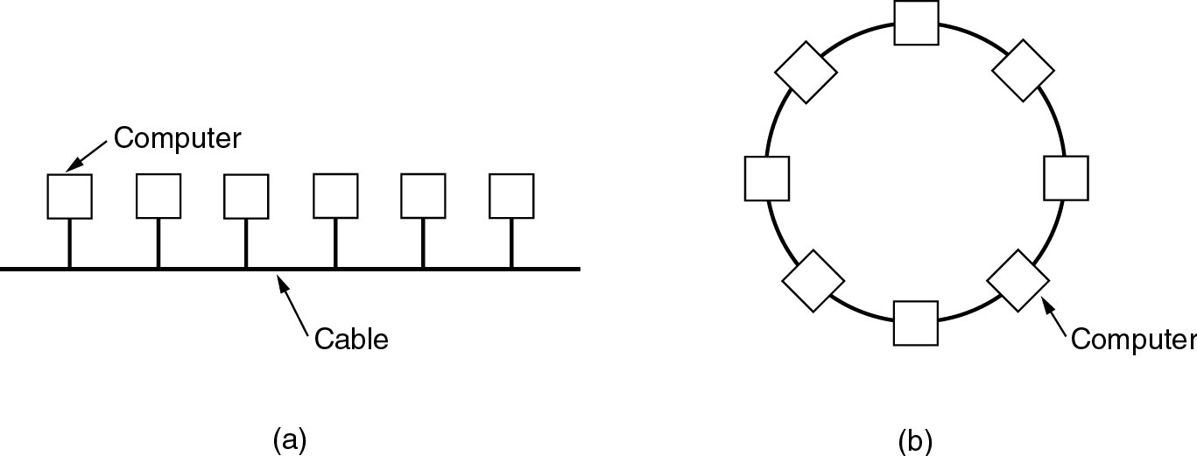
Topology
Two broadcast networks
(a) Bus
(b) Ring

Slide 29
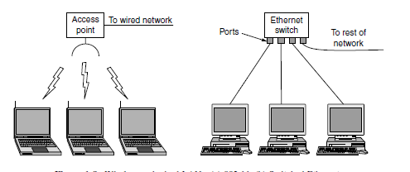
802.11/Switched LAN

Slide 30
Channel allocation
Static & Dynamic
A typical static allocation
Divide time into discrete intervals and use a round-robin algorithm, allowing each machine to broadcast only when its time slot comes up
Dynamic allocation methods
Centralized
Decentralized

Slide 31
MAN and WAN

Slide 32
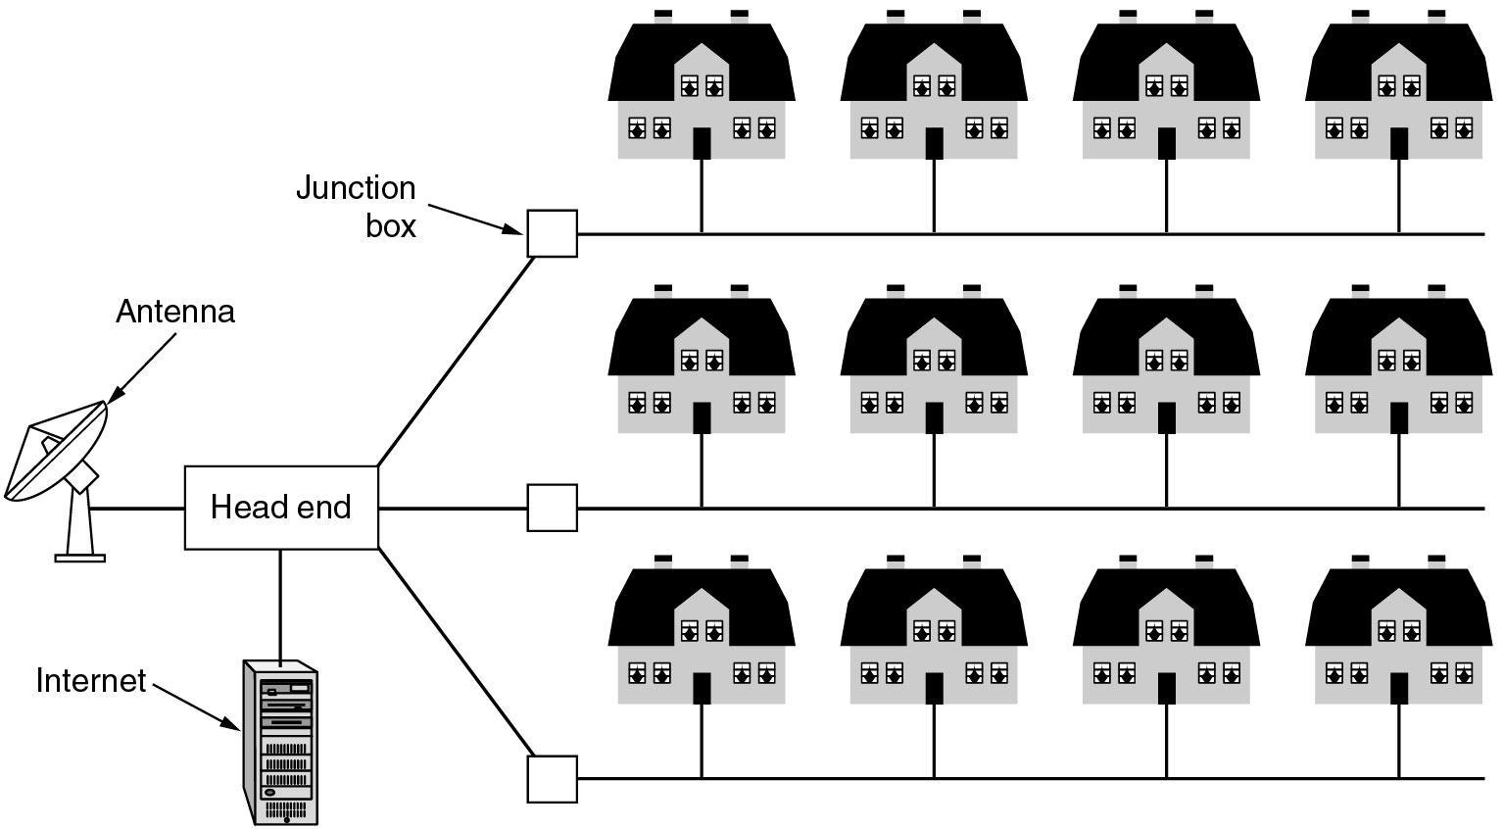
Metropolitan Area Networks
A metropolitan area network based on cable TV

Slide 33
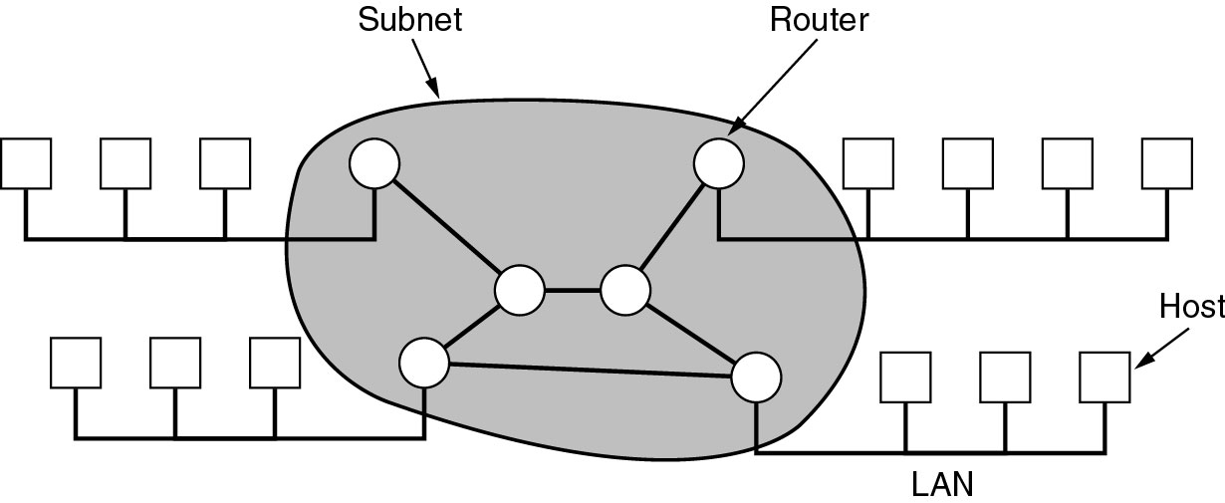
WAN
WAN: telecommunication network that covers a broad area
Providing connections from a LAN to the Internet

Slide 34
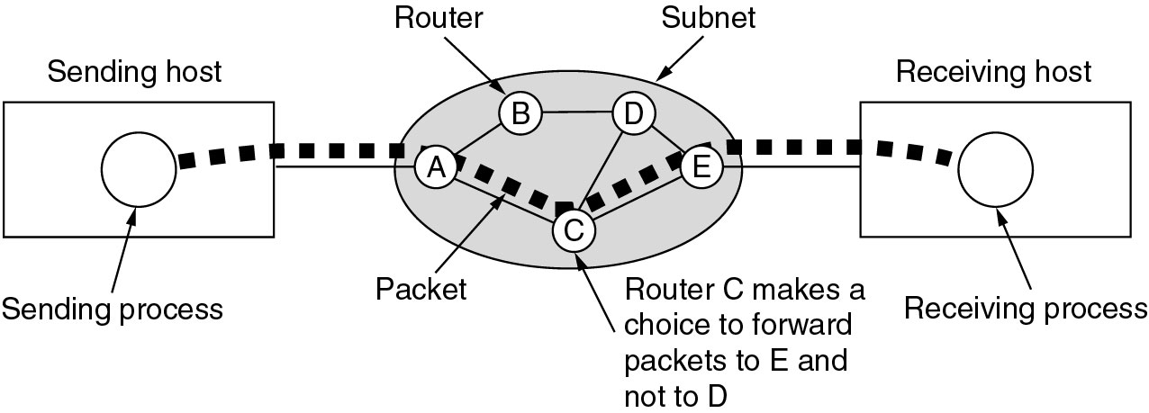
Communication subnet
Transmission lines
Switching elements (Router)
Store-and-forward (packet-switched)
reassembled
Routing decisions: Routing algorithm

Slide 35
Wireless Networks

Slide 36
Categories of wireless networks
System interconnection
Bluetooth
In the simplest form, system interconnection networks use the master-slave paradigm
Wireless LANs(802.11-WiFi)
Wireless MANs(802.16 WiMax)
Wireless WANs

Slide 37
Internetworks

Slide 38
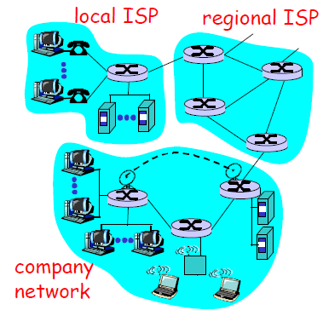
Internet & internet
A collection of interconnected networks is called an internetwork or internet
Gateway: provide the necessary translation, both in terms of hardware and software
The worldwide Internet (which is one specific internet)
[J. Kurose]

Slide 39
Subnet, Network, internet
Subnet
The collection of routers and communication lines
Network
The combination of a subnet and its hosts forms a network
internetwork
An internetwork is formed when distinct networks are interconnected

Slide 40
1.3 Network Software

Slide 41
Protocol Hierarchies

Slide 42
Network architecture
Networks are organized as a stack of layers
Reduce design complexity
The purpose of each layer is to offer certain services to the higher layers, shielding those layers from the details of how the offered services are actually implemented
Each layer is a kind of virtual machine, offering certain services to the layer above it
Object-oriented programming
A particular piece of software (or hardware) provides a service to its users but keeps the details of its internal state and algorithms hidden from them
Notes:
Networks are complex!
many “pieces”:hosts, routers, links of various media, applications, protocols. hardware, software
Question: Is there any hope of organizing structure of network?

Slide 43
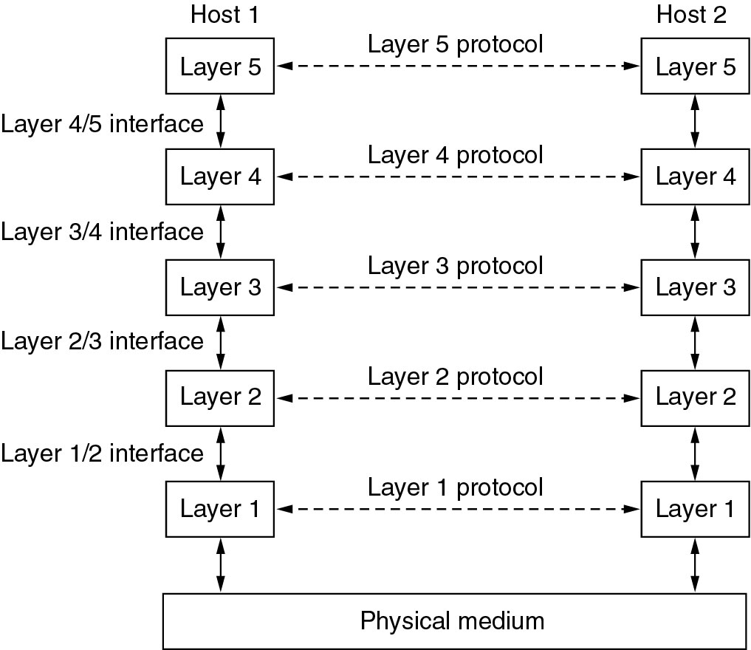
Layers, Peers, Protocols, and Interfaces

Slide 44
Layers, protocols, and interfaces
Protocol
An agreement between the communicating parties on how communication is to proceed
Peers
The entities comprising the corresponding layers on different machines are called peers
The peers may be processes, hardware devices
Physical medium
Interface
Defines which primitive operations and services the lower layer makes available to the upper one
Network architecture
A set of layers and protocols
Neither the details of the implementation nor the specification of the interfaces is part of the architecture

Slide 45
Philosopher-Translator-Secretary
Interfaces
Protocols
Translator: A neutral language known to both of them
Secretary: communication method

Slide 46
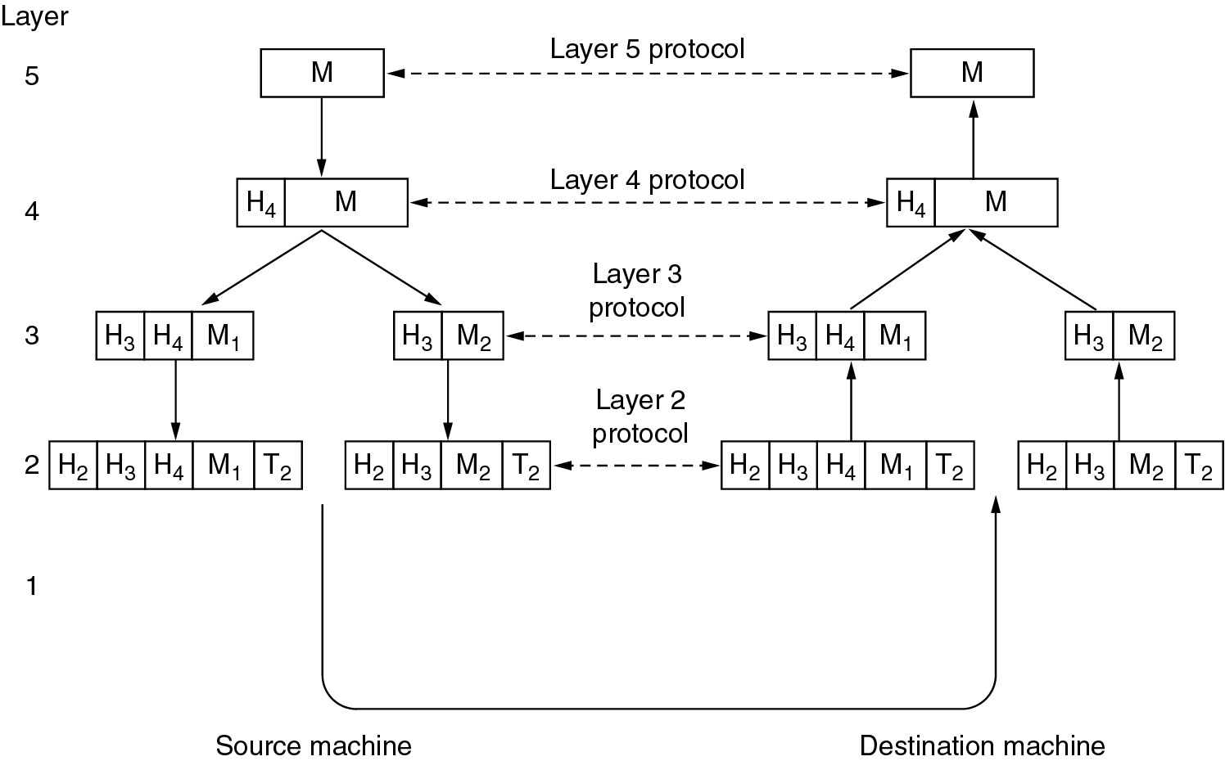
Information flow
Example information flow supporting virtual communication in layer 5.
Notes:
类比：A公司北京总部人事部的Alice想要给南京分公司网络部的Bob发送一份工资单（Layer 5 Message），这个通知装在公司内部信封中，上面有Bob的部门和名字（Layer 4 Message），行政助理将这个信封装在统一的邮政信封中，并写上南京分公司的地址和北京总公司的地址（Layer 3 Message）, 邮局将邮政信封发到南京分公司，行政助理接收，拆开，将内部信封交给Bob；Bob打开信封，看到工资单。

Slide 47
Virtual Communication of Layer 5 Peers(1)
Layer 5
A message, M, is produced by an application process and given to layer 4 for transmission
Layer 4
Puts a header in front of the message to identify the message and passes the result to layer 3
Header: control information, such as sequence numbers (In some layers, headers can also contain sizes, times, and other control fields)

Slide 48
Virtual Communication of Layer 5 Peers(2)
Layer 3
There is limit to the size of messages transmitted in the layer 3 protocol
Break up the incoming messages into smaller units (packets)
Prepend a layer 3 header to each packet
Decides which of the outgoing lines to use and passes the packets to layer 2
Layer 2
Adds a header & trailer to each piece
Gives the resulting unit to layer 1
Layer 1
Physical transmission

Slide 49
A Practical Case
source
message
M
application
transport
network
link
physical
segment
H_{t}
M
datagram
H_{n}
H_{t}
M
frame
H_{l}
H_{n}
H_{t}
M
H_{l}
H_{n}
H_{t}
M
link
physical
H_{l}
H_{n}
H_{t}
M
switch
destination
H_{n}
H_{t}
M
network
link
physical
H_{n}
H_{t}
M
M
application
transport
network
link
physical
H_{l}
H_{n}
H_{t}
M
H_{l}
H_{n}
H_{t}
M
H_{t}
M
H_{n}
H_{t}
M
H_{l}
H_{n}
H_{t}
M
router

Slide 50
Design Issues for the Layers

Slide 51
Design Issues for the Layers
Reliability
Error detection and error correction
Routing: find a path through a netwrok
Network evolution
Protocol layering
Addressing or naming: identifying senders and receivers
Internetworking（网络互通性）
Scalability(可扩展性)
Resource allocation
Statistical multiplexing（统计复用：按需分配）
Flow Control(流量控制)
QoS（服务质量）
Security

Slide 52
Error Control
Physical lines are not perfect
Error-detecting & Error-correcting codes
How the receiver tells the sender which messages have been correctly received and which have not
Messages may be out of sequence
How the sender numbers the messages
How the receiver deals with the messages arriving out of order

Slide 53
Addressing
Each layer needs a mechanism for identifying senders and receivers
Sender: a process on a machine
Receiver: a process on another machine

Slide 54
Flow Control
A fast sender may swamp a slow receiver with data
Method 1: some kind of feedback from the receiver to announce it’s current situation
Method 2: limit the sender’s transmission rate

Slide 55
Routing
When multiple paths exist, a route must be chosen

Slide 56
Service Primitives

Slide 57
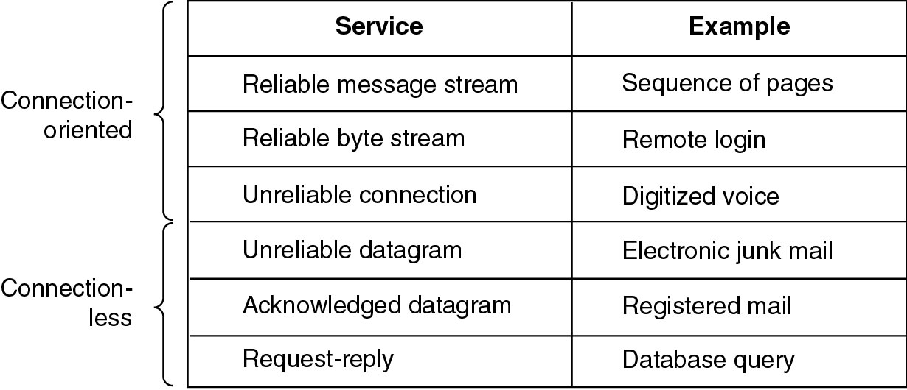
Connection-Oriented and Connectionless Services
Connection-oriented: telephone system
Connection-less: postal system
Six different types of service

Slide 58
Interfaces and services
Service provider and service user
The entities in layer n implement a service used by layer n+1, layer n is called the services provider, layer n+1 is called service user
SAP: Service Access Point
Layer n SAPs are the places where layer n+1 can access the services offered
PDU: Protocol Data Unit
Information exchanged between two peers

Slide 59
Service Primitives
A service is formally specified by a set of primitives (operations) available to a user process to access the service
Example
CONNECT.request - request a connection to be established
CONNECT.indication - signal the called party
CONNECT.response - used by the called to accept/reject calls
CONNECT.confirm – tell the caller whether the call was accepted
DATA.request – request that data be sent
DATA.indication – signal the arrival of data
DISCONNECT.request – request that a connection be released
DISCONNECT.indication – signal the peer about the request

Slide 60
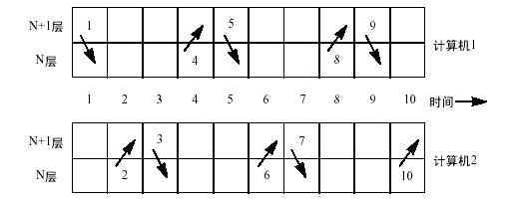
Service Primitives: Example
1. CONNECT.request
2. CONNECT.indication
3. CONNECT.response
4. CONNECT.confirm
5. DATA.request
6. DATA.indication
7. DATA.request
8. DATA.indication
9. DISCONNECT.request
10.DISCONNECT.indication

Slide 61
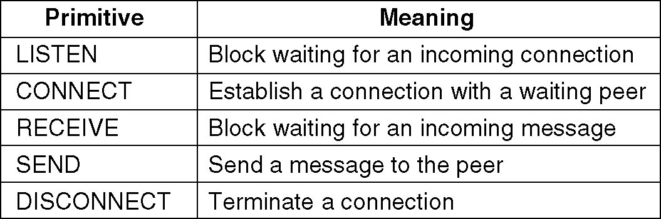
A Simple Connection-oriented Service
If the protocol stack is located in the operating system, the primitives are normally system calls
Five service primitives for implementing a simple connection-oriented service.

Slide 62
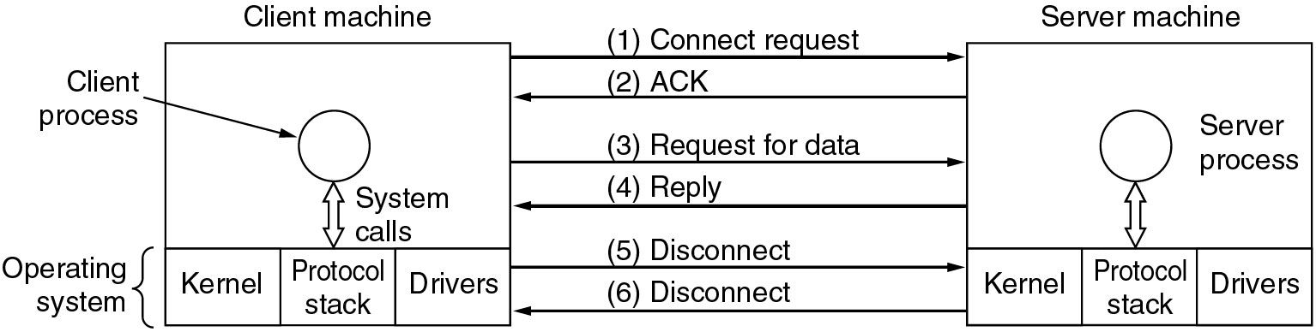
A Simple Connection-oriented Service
Packets sent in a simple client-server interaction on a connection-oriented network.

Slide 63
The Relationship of Services to Protocols
Service
Defines what operations the layer is prepared to perform on behalf of its users, but it says nothing at all about how these operations are implemented
Relates to an interface between two layers, with the lower layer being the service provider and the upper layer being the service user
Protocol
A set of rules governing the format and meaning of the messages that are exchanged by the peer entities
Entities use protocols to implement their service definitions
Service and protocol are completely decoupled
They are free to change their protocols provided they do not change the service

Slide 64
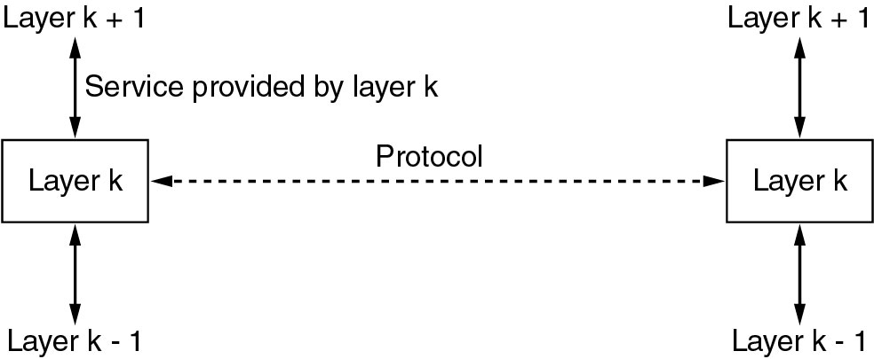
The Relationship of Services to Protocols

Slide 65
1.4 Reference Models

Slide 66
The OSI Reference Model

Slide 67
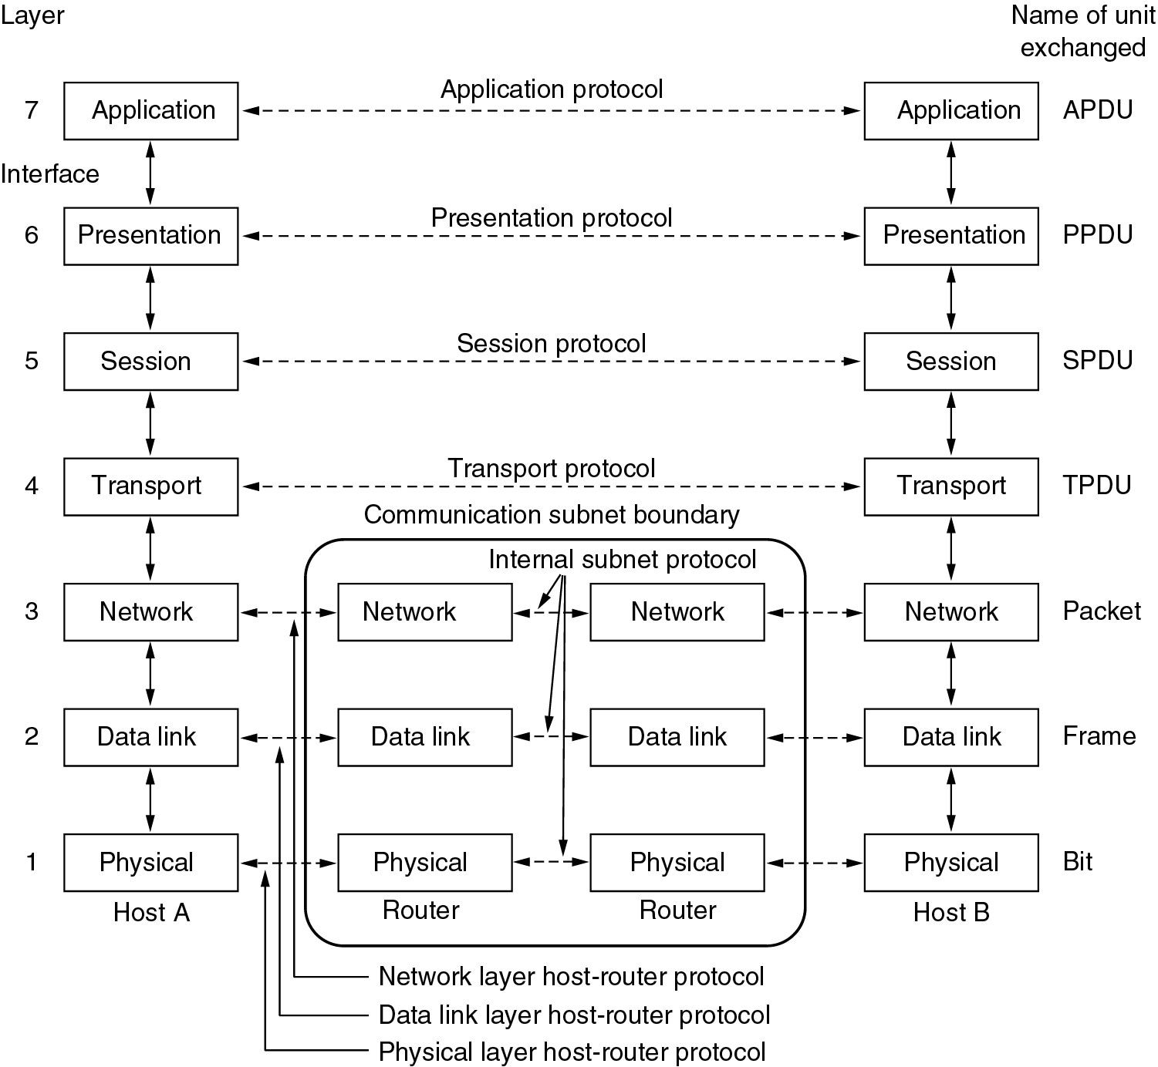
The OSI reference model

Slide 68
Physical layer
Transmitting raw bits over a communication channel
how many volts should be used to represent a 1 and how many for a 0
how many nanoseconds a bit lasts
whether transmission may proceed simultaneously in both directions
how the initial connection is established and how it is torn down when both sides are finished

Slide 69
Data link layer
Transform a raw transmission facility into a logic channel (Point-to-Point: the protocols are between each machine and its immediate neighbors)
Sender break up the input data into data frames and transmit the frames
If the service is reliable, the receiver confirms correct receipt of each frame by sending back an acknowledgement frame
Flow control: Keep a fast transmitter from drowning a slow receiver in data
Broadcast networks: how to control access to the shared channel

Slide 70
Network layer
Controls operation of subnet
Forwarding
Routing: How packets are routed from source to destination (route table)
Static
Be determined at start of each conversation
Highly dynamic
Congestion
QoS (Quality of service)
delay, transit time, jitter, etc.
Heterogeneous networks interconnection
Broadcast networks, routing is simple

Slide 71
Transport Layer
Transport Layer: end-to-end layer
Accept data from above, split it up into smaller units if need be, pass these to the network layer, and ensure that the pieces all arrive correctly at the other end
Determines what type of service to provide to the session layer
an error-free end-to-end channel
transporting of isolated messages, with no guarantee about the order of delivery
broadcasting of messages to multiple destinations

Slide 72
Session Layer
The session layer allows users on different machines to establish sessions
Dialog control
keeping track of whose turn it is to transmit
Token management
preventing two parties from attempting the same critical operation at the same time
Synchronization
checkpointing long transmissions to allow them to continue from where they were after a crash

Slide 73
Presentation Layer
The syntax and semantics of the information transmitted
the data structures to be exchanged can be defined in an abstract way

Slide 74
Application Layer
Application layer contains a variety of protocols that are commonly needed by users.
HTTP (HyperText Transfer Protocol)
File transfer
Electronic mail
Network news
…….

Slide 75
The TCP/IP Reference Model

Slide 76
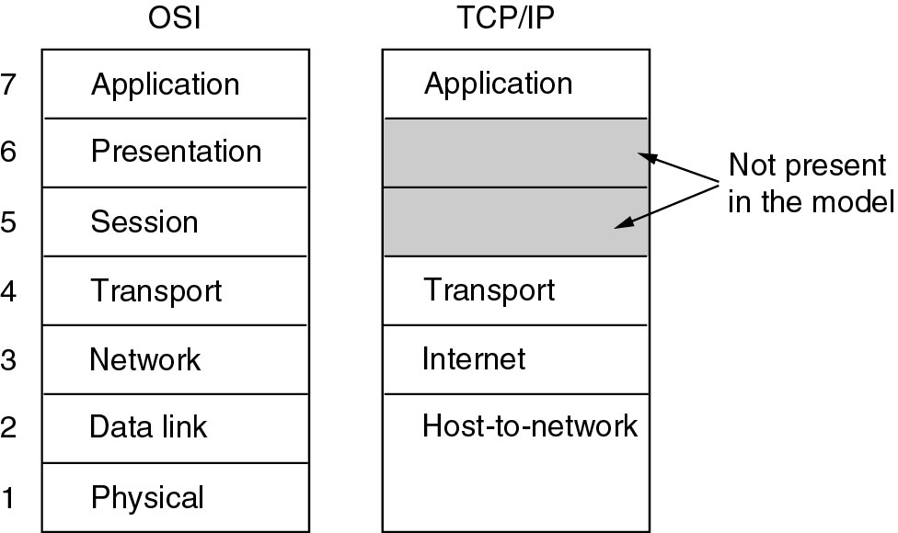
The TCP/IP Reference Model

Slide 77
The Internet Layer
A packet-switching network based on a connectionless internetwork layer
Defines an official packet format and protocol called IP (Internet Protocol)
The job of the internet layer is to deliver IP packets where they are supposed to go
Packet routing
Avoiding congestion

Slide 78
The Transport Layer: TCP
TCP (Transmission Control Protocol)
Reliable connection-oriented protocol that allows a byte stream originating on one machine to be delivered without error on any other machine in the internet
Fragments incoming byte stream into discrete messages
Reassembles the received messages into the output stream
Flow control to make sure a fast sender cannot swamp a slow receiver with more messages than it can handle

Slide 79
The Transport Layer: UDP
UDP (User Datagram Protocol)
Unreliable, connectionless protocol
For applications that do not want TCP's sequencing or flow control and wish to provide their own (i.e. NFS)
For applications in which prompt delivery is more important than accurate delivery, such as transmitting speech or video, DNS

Slide 80
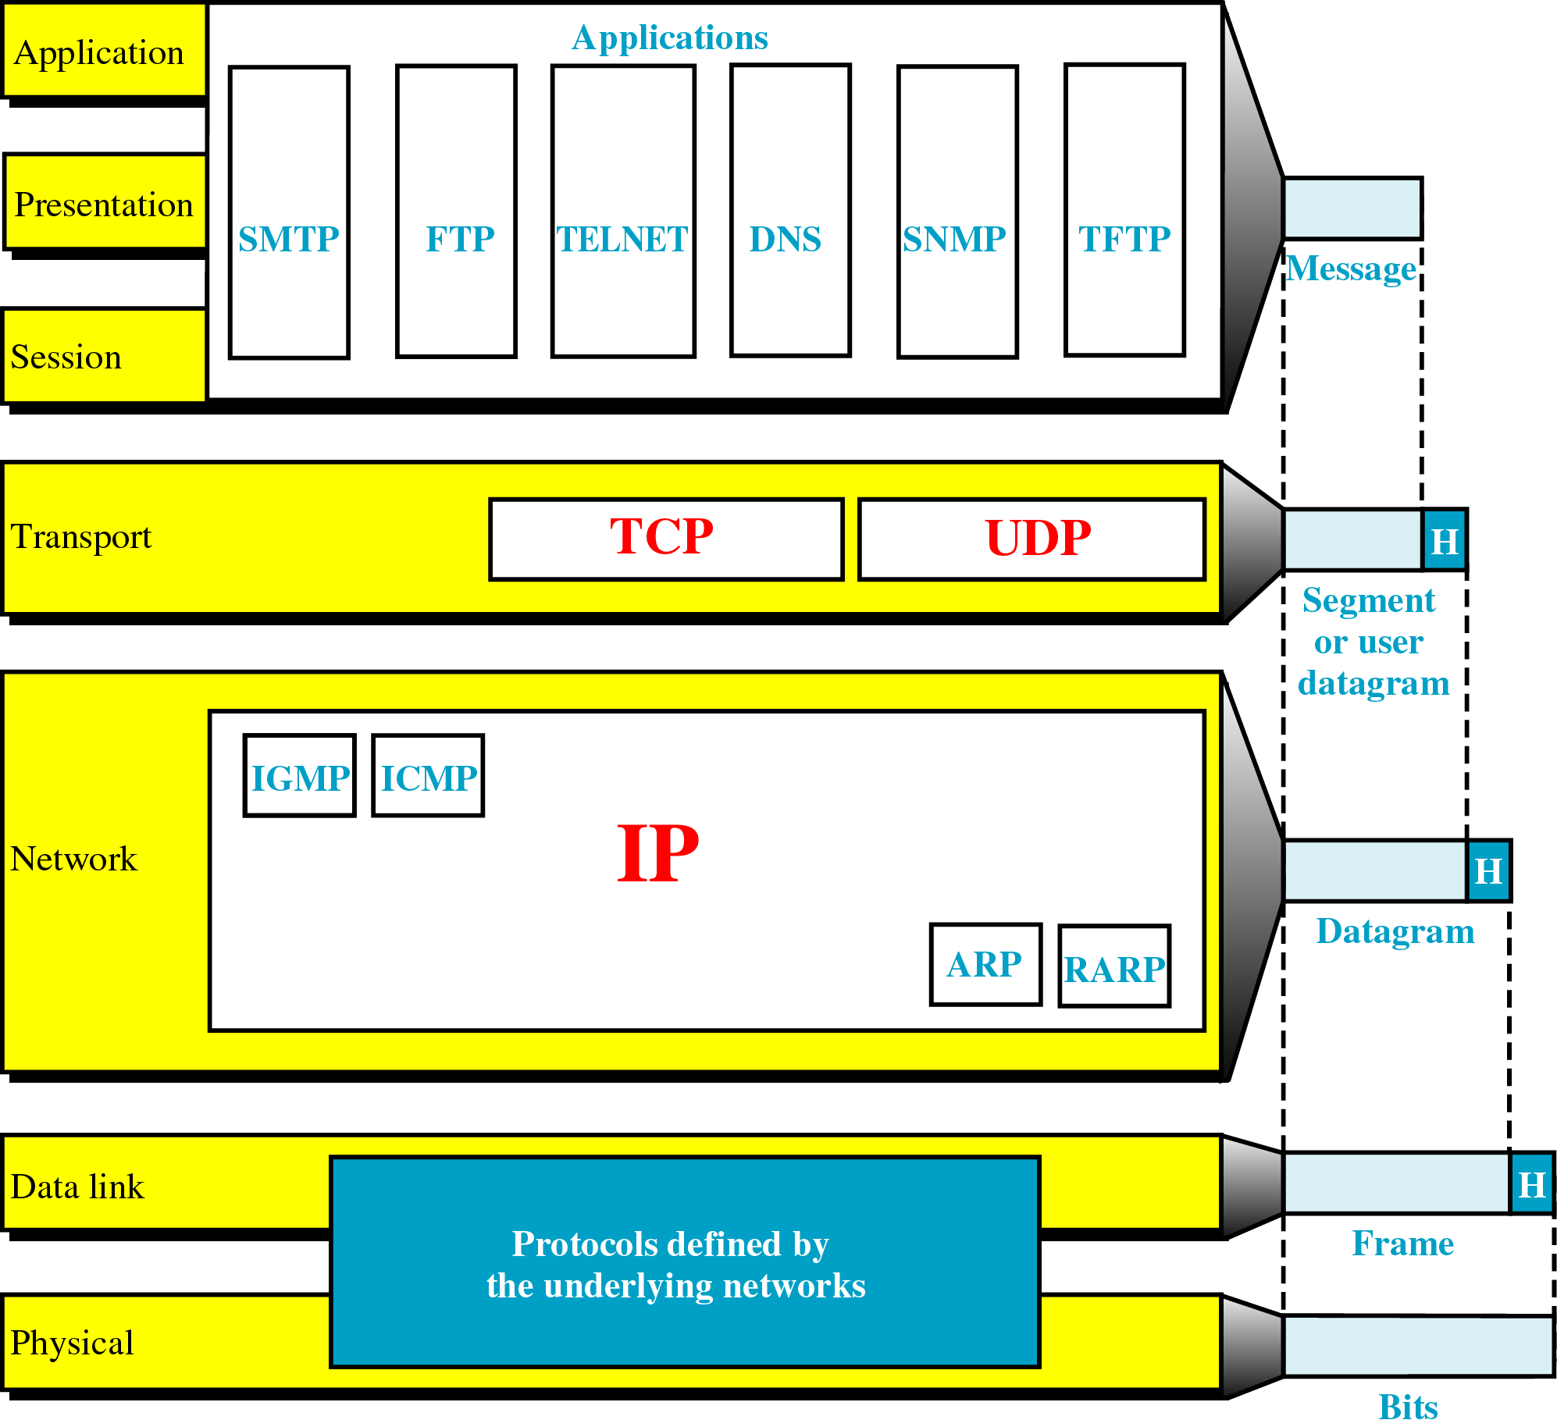
TCP/IP Model: in Details

Slide 81
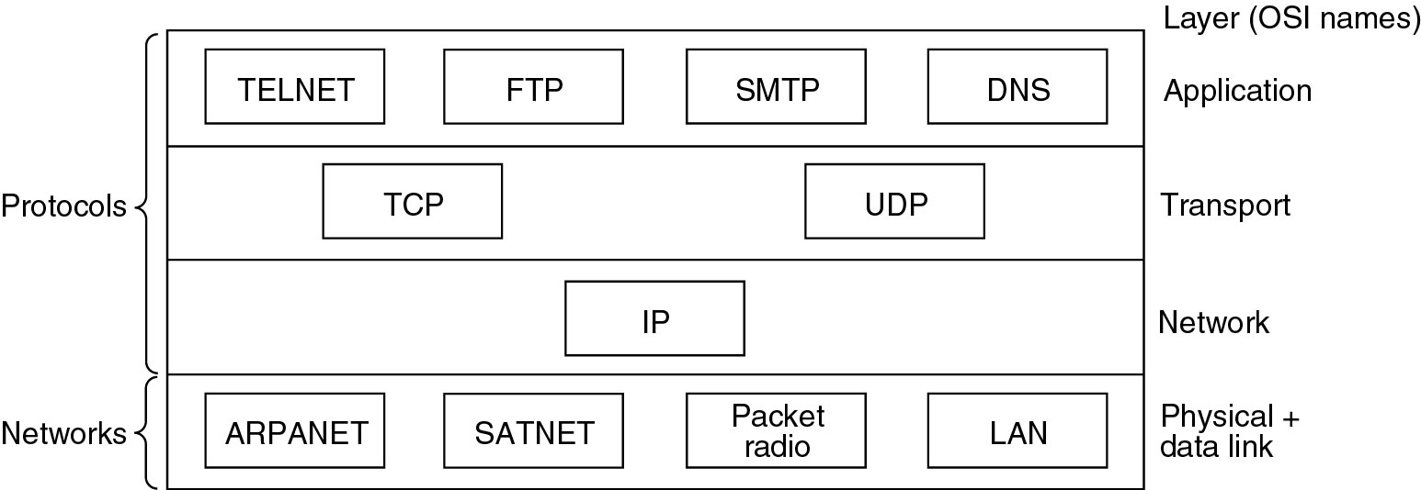
Protocols & networks in the TCP/IP
Protocols and networks in the TCP/IP model initially.

Slide 82
Comparing OSI and TCP/IP Models

Slide 83
3 Concepts are Central to OSI Model
Services
What the layer does, not how entities above it access it or how the layer works. It
Interfaces
Tells the processes above it how to access it.
Protocols

Slide 84
A Critique of the OSI Model & Protocols
Why OSI did not take over the world
Bad timing
Bad technology
Bad implementations
Bad politics

Slide 85
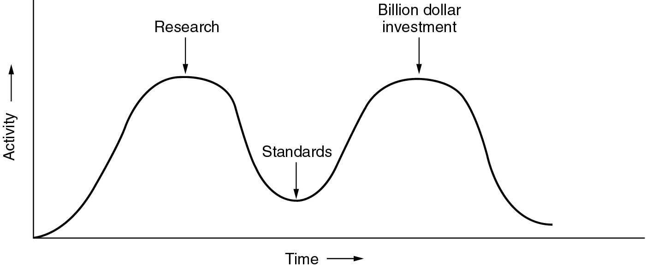
Bad Timing
The apocalypse of the two elephants.

Slide 86
Bad Technology
The choice of seven layers was more political than technical, and two of the layers (session and presentation) are nearly empty, whereas two other ones (data link and network) are overfull
Service definitions and protocols are extraordinarily complex and difficult to implement and inefficient in operation
Some functions, such as addressing, flow control, and error control, reappear again and again in each layer

Slide 87
A Critique of the TCP/IP Reference Model
Problems
Service, interface, and protocol not distinguished
Not a general model
Host-to-network “layer” not really a layer
No mention of physical and data link layers
Minor protocols deeply entrenched, hard to replace

Slide 88
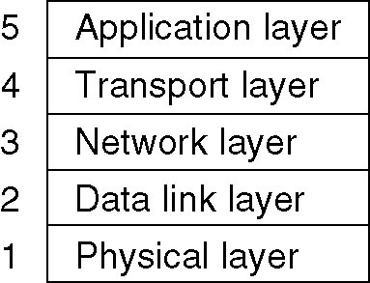
Hybrid Model
The hybrid reference model to be used in this book.

Slide 89
1.5 Example Networks

Slide 90
Example Networks
The Internet
The mobile phone network
Wireless LANs: 802.11
RFID/ Sensor networks

Slide 91
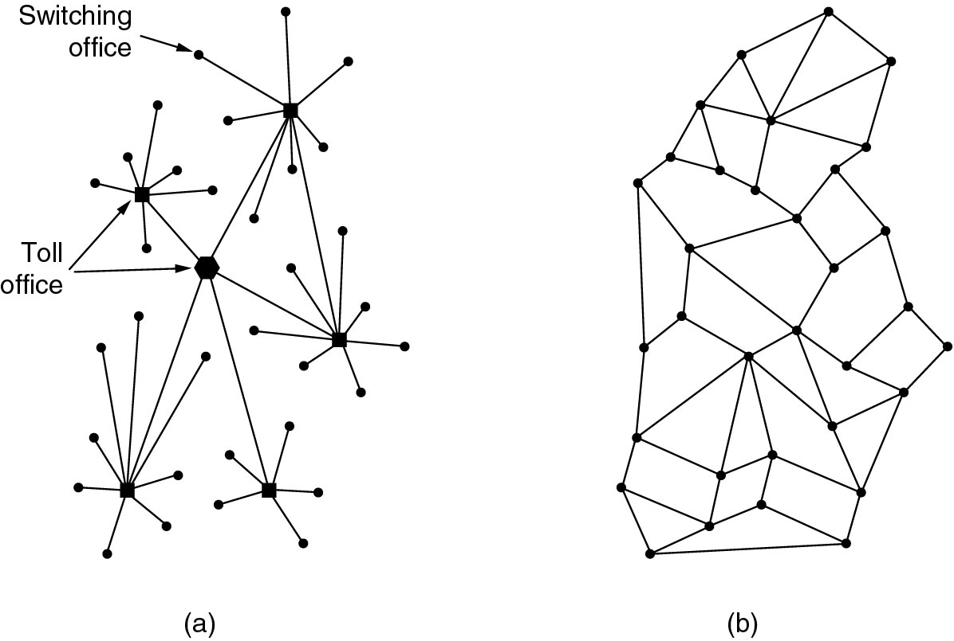
The ARPANET
(a) Structure of the telephone system
(b) Baran’s proposed distributed switching system
Notes:
Baran: packet-switching in military nets

Slide 92
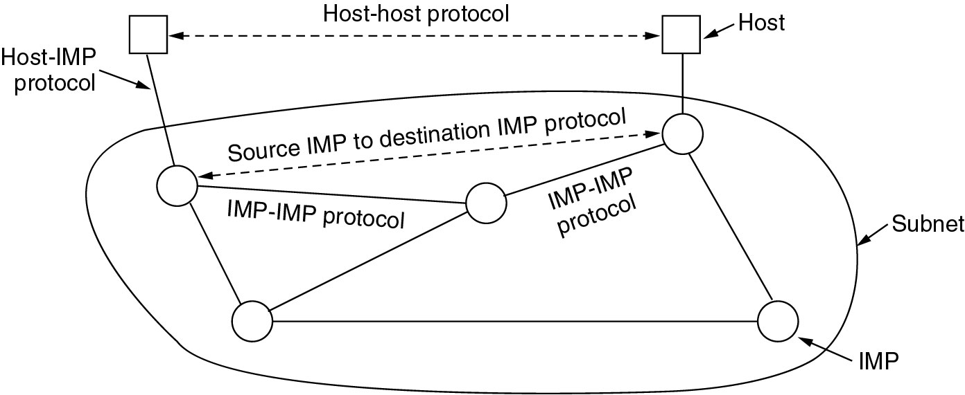
The Original ARPANET Design
Notes:
1961: Kleinrock - queueing theory shows effectiveness of packet-switching
1964: Baran - packet-switching in military nets
1967: ARPAnet conceived by Advanced Research Projects Agency
1969: first ARPAnet node operational

Slide 93
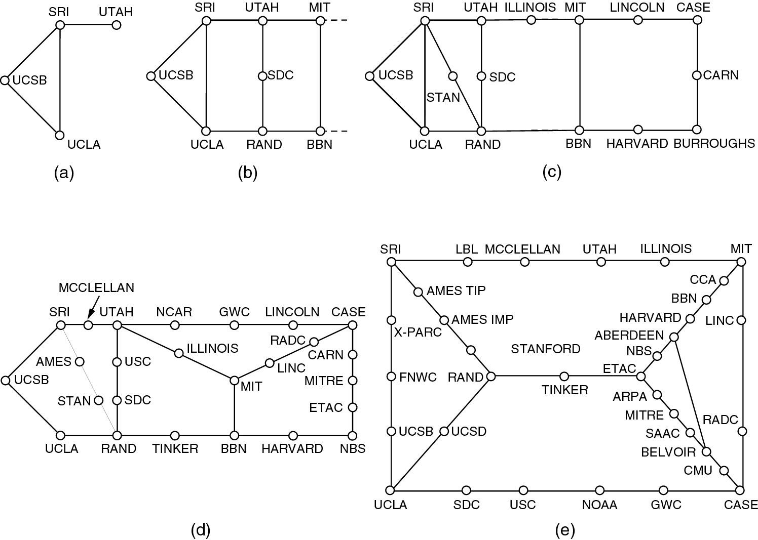
Growth of the ARPANET
(a) December 1969 (b) July 1970 (c) March 1971
(d) April 1972. (e) September 1972.

Slide 94
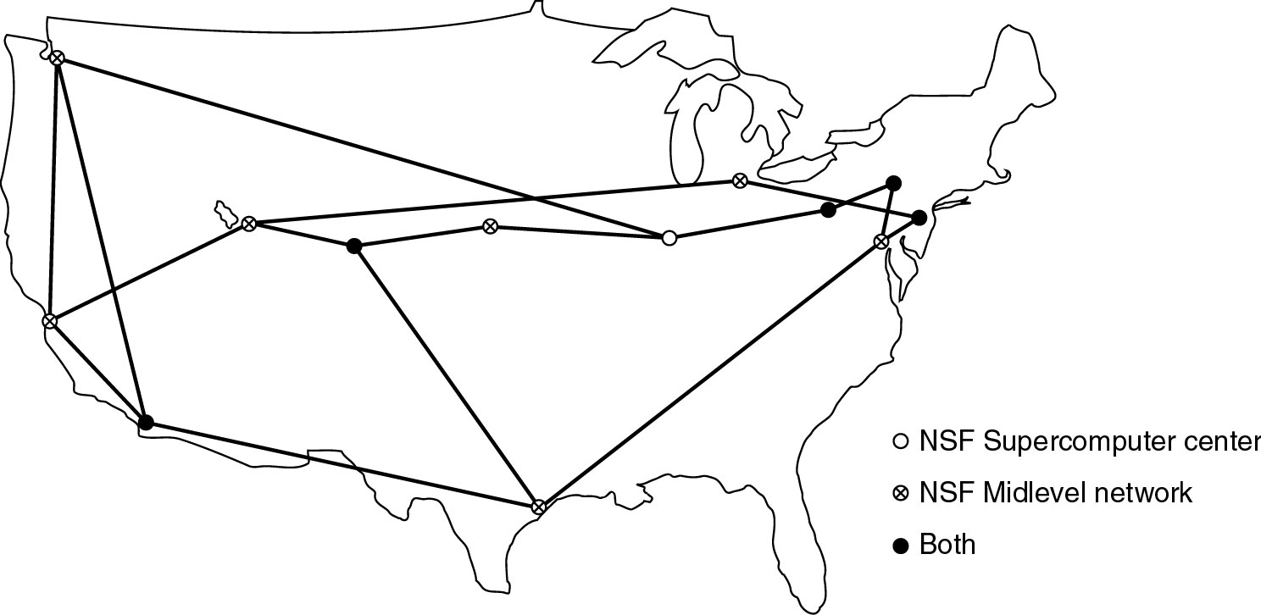
NSFNET
The NSFNET backbone in 1988.

Slide 95
Internet Usage
Traditional applications (1970 – 1990)
E-mail
News
Remote login
File transfer
1990-
WWW (World Wide Web) brought millions of new, nonacademic users to the net

Slide 96
Architecture of the Internet
Overview of the Internet.

Slide 97
The mobile phone network

Slide 98
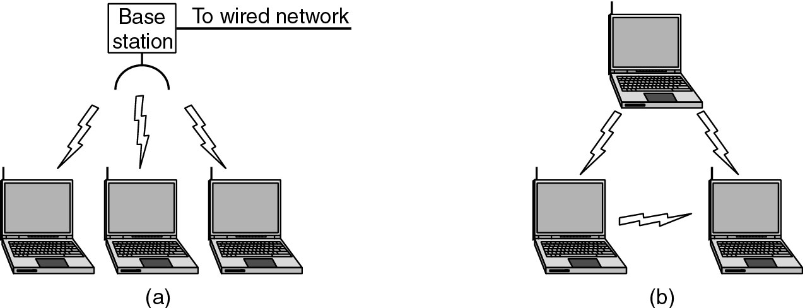
Wireless LANs
(a) Wireless networking with a base station.
(b) Ad hoc networking.

Slide 99
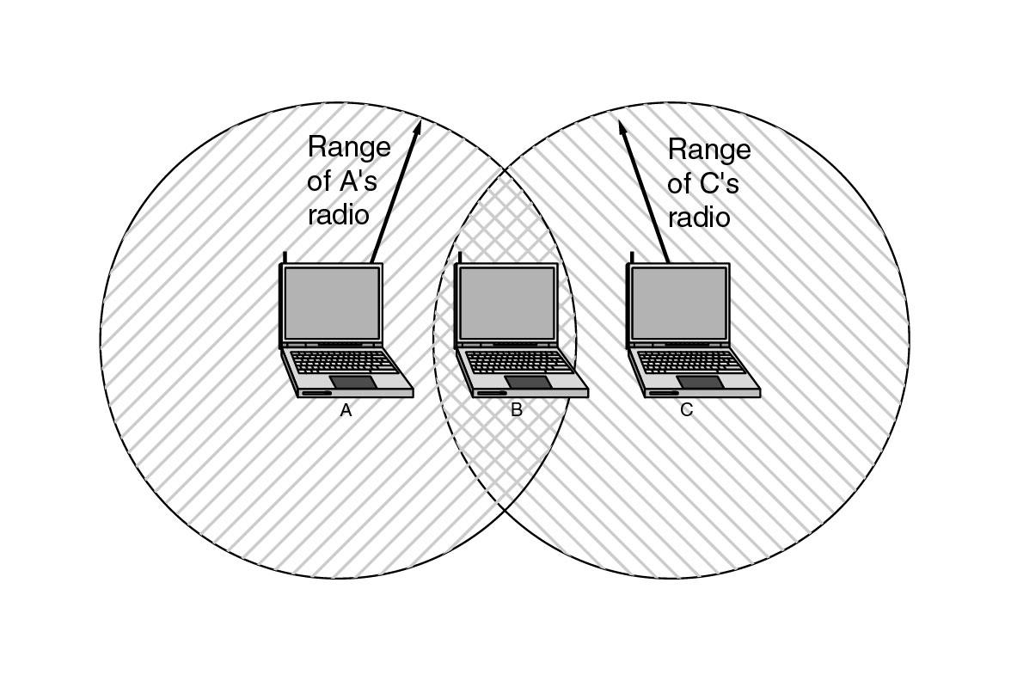
Wireless LANs (2)
The range of a single radio may not cover the entire system.

Slide 100
RFID / Sensor network

Slide 101
Connection-Oriented Networks
X.25 (2.4K~64K)
a computer first established a connection to the remote computer (Virtual Circuit)
Data packet consists of a 3-byte header (VC#/seq#/ACK#) and up to 128 bytes of data.
Frame Relay (9.6K~2M)
a connection-oriented network with no error control and no flow control
ATM (155M/622M)
Transmit information in fixed-size packets called cells
The cells are 53 bytes long, of which 5 bytes are header and 48 bytes are payload

Slide 102
1.6 Network Standardization

Slide 103
Network Standardization
Telecommunications World
ITU (International Telecommunication Union)
Main sectors
Radio communications(ITU-R)
Telecommunications Standardization(ITU-T)
CCITT, Comité Consultatif International Télégraphique et Téléphonique (1956-1993)
Development(ITU-D)
International Standards World
ISO (International Standards Organization)
ANSI (American National Standards Institute)
IEEE (Institute of Electrical and Electronics Engineers)

Slide 104
Internet Standards World
Internet协会（ISOC，Internet Society）
推动、支持和促进Internet不断增长和发展的专业组织
它把Internet作为全球研究通信的基础设施
体系结构委员会（IAB，Internet Architecture Board）
技术监督和协调的机构。它由国际上来自不同专业的1 5个志愿者组成，其职能是负责Internet标准的最后编辑和技术审核
工程任务组（IETF，Internet Engineering Task Force）
面向近期标准的组织，它分为9个领域（应用、寻径和寻址、安全等等）。IETF开发成为Internet标准的规范
研究任务组（IRTF，Internet Research Task Force）
主要对长远的项目进行研究
IRTF和IETF隶属于IAB， IAB隶属于ISOC
所有关于Internet的标准都以RFC(Request for Comment)文档出版
Proposed Standard->Draft Standard->Internet Standard

Slide 105
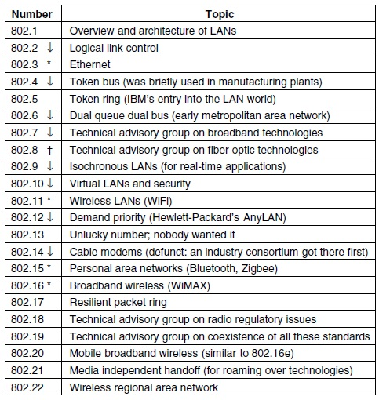
IEEE 802 Standards
The 802 working groups. The important ones are marked with *. The ones marked with ↓ are hibernating. The one marked with † gave up.

Slide 106
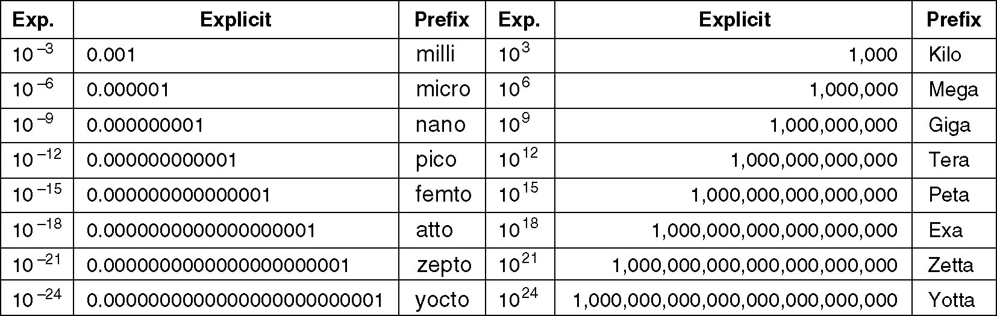
Metric Units
The principal metric prefixes
milli and micro both begin with the letter ''m', Normally, ''m'' is for milli and ''µ'' (the Greek letter mu) is for micro

Slide 107
Highlights
purpose
subnet
classification
layer
protocol architecture
ISO OSI/rm
service primitive
connect 、connectless
famous architecture/Organization

Slide 108
Homework
2, 3,9, 10, 11,16, 17, 18,30

